Slide 1

Mental Health eScreening System Administration Training

Slide 2
Welcome to MHE!
Mental Health eScreening (MHE) is a software application for automating the manual, paper-based process of screening Veterans for mental health issues. It consists of a web-based assessment runtime, a database for storing assessment data, a web-based WYSIWYG editor for designing assessments and notes templates, and a web administrative dashboard for operating the system.
The application exchanges data directly with VistA, primarily consisting of pulling open clinical reminders, pulling Veteran identification and demographic data, inserting Veteran assessment data in the form of notes, and closing clinical reminders based on completion of assessments, as well as creating new clinical reminders and inserting health factors based on the results of screening.

Slide 3
Modules
First, we’ll look at the physical system.
Hardware
Software
MHE Deployment
Routine Operations
Exception Handling
Operations & Maintenance System Support
Notes:
A self-review follows most topics.

Slide 4
Modules
Hardware
Physical System
Logical System
Logical Integration
Workflow
Logic Data Integration
Software
MHE Deployment
Routine Operations
Exception Handling
Operations & Maintenance System Support
Notes:
A self-review follows most topics.

Slide 5
Physical System
The physical eScreening hardware consists of one physical server and up to 600 tablets. The eScreening application runs on the physical server in the San Diego data center. Staff access the dashboard and designer components from VA workstations. Staff and Veterans access the runtime component from HTML5-capable browsers on tablet devices.
The tablets connect to the server and the server connects to VistA. The tablets talk HTTP over TLS to the server via a SD VAMC 11g wireless network. The eScreening server communicates with Cache via RPC over VistA port.
Notes:
Here’s a diagram of the connections: (next slide)

Slide 6
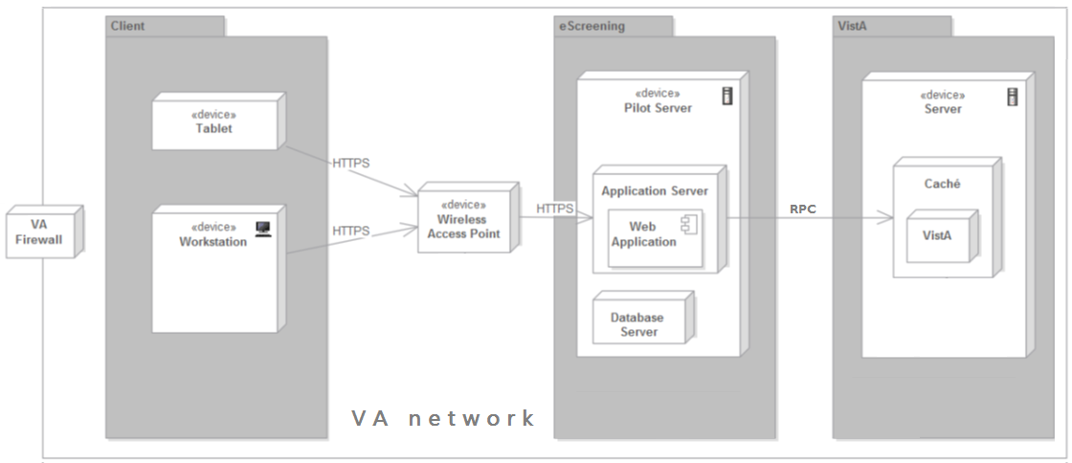
Physical System
Notes:
I do not believe we need to specify the connection between

Slide 7
Physical System
Hardware specs:
Item | Make | Model | OS | Memory | Storage | Location
Server | Dell | R420 | Windows Server 2012 | 64 GB | 1.2 TB (after RAID 10) | VASD data center
Tablet | Samsung | Slate | Windows 7 Enterprise | 4 GB | 118 GB | SD VAMC
Tablet | Apple | iPad2 | iOS 7.1 | 512 MB | 16 GB | Each program location
Notes:
Here’s a diagram of the connections: (next slide)

Slide 8
Logical System
Notes:
MHE designs, performs, and publishes mental health assessments, and contains a data repository and an existing VistA instance.
Components are:
WYSIWYG Editor:
for designing assessment forms and note templates. Staff use the designer to create or edit existing assessment and notes templates; the assessment forms are then used by the assessments runtime and the notes templates are used by the dashboard.
Runtime:
executes assessment forms created by the designer. Veterans “take” assessments by inputting answers into questions within forms based on the templates. The assessment session and the answer to the forms are stored in the repository.
Dashboard:
allows staff to create assessment sessions based on assessment forms, view the status of ongoing assessments, and upload the results of assessments to VistA based on note templates created by the designer. The dashboard uses the repository to track and store assessments and templates.
Database:
A repository of assessment forms, users, ongoing and historical assessments, and assessment metadata used by the designer, runtime, and dashboard.
The next slide shows the integration between MHE, the repository, and VistA:

Slide 9
Logical System Description
The application components are as follows:
WYSIWYG Editor: A What You See is What You Get (WYSIWYG) tool for designing assessment forms and note templates. Staff use the designer to create or edit existing assessment and notes templates; the assessment forms are then used by the assessments runtime and the notes templates are used by the dashboard.
Runtime: The runtime executes assessment forms created by the designer. Veterans “take” assessments by inputting answers into questions within forms based on the templates. The assessment session and the answer to the forms are stored in the repository.
Dashboard: The dashboard allows staff to create assessment sessions based on assessment forms, view the status of ongoing assessments, and upload the results of assessments to VistA based on note templates created by the designer. The dashboard uses the repository to track and store assessments and templates.
Database: A repository of assessment forms, users, ongoing and historical assessments, and assessment metadata used by the designer, runtime, and dashboard.
Notes:
MHE designs, performs, and publishes mental health assessments, and contains a data repository and an existing VistA instance.
Components are:
WYSIWYG Editor:
for designing assessment forms and note templates. Staff use the designer to create or edit existing assessment and notes templates; the assessment forms are then used by the assessments runtime and the notes templates are used by the dashboard.
Runtime:
executes assessment forms created by the designer. Veterans “take” assessments by inputting answers into questions within forms based on the templates. The assessment session and the answer to the forms are stored in the repository.
Dashboard:
allows staff to create assessment sessions based on assessment forms, view the status of ongoing assessments, and upload the results of assessments to VistA based on note templates created by the designer. The dashboard uses the repository to track and store assessments and templates.
Database:
A repository of assessment forms, users, ongoing and historical assessments, and assessment metadata used by the designer, runtime, and dashboard.
The next slide shows the integration between MHE, the repository, and VistA:

Slide 10
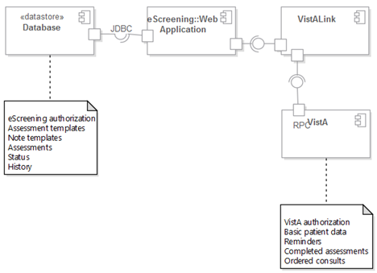
Logical Integration
This shows how the application, the repository, and VistA integrate.
Notes:
You can see here that … (whatever) …

Slide 11
Modules
Hardware
Software
MHE Deployment
Routine Operations
Exception Handling
Operations & Maintenance System Support

Slide 12
Software System
Web application: JavaScript, HTML5, and CSS3 on the presentation layer; Java on the service and data access layers. The application performs authentication/authorization against the eScreening database. It provides screening services to Veterans, and administration and reporting features to staff. The application integrates with VistA via VistALink.
Database: A MySQL database that stores Veteran screening data and metadata, as well as VA staff credentials and permissions.
VistA: The application integrates with VistA for security, basic Veteran data, clinical reminders, health factors, consults, and notes.

Slide 13
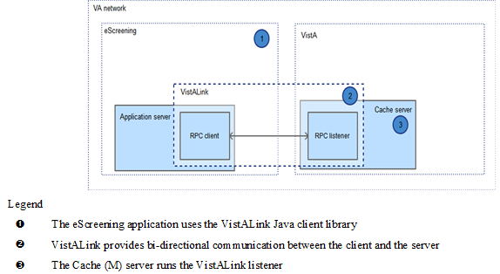
Software Communications
All communication between MHE and VistA takes place behind VA firewalls via VA VistALink, an RPC framework that is part of the OneVA architecture. We have identified the RPC that CPRS makes and are re-using them as fits eScreening.
Notes:
All communication between MHE and VistA takes place behind VA firewalls via VA VistALink, a Java RPC framework
that is part of the OneVA architecture.
MHE uses VistALink for bidirectional communications between the client and VistA (M) server, and utilizes existing CPRS RPCs
to perform the same actions as CPRS without requiring any VistA code changes.

Slide 14
Software Description
MHE runs on the VA network. Veterans and VA staff access the application via web pages over VPN or VA networks. It allows the staff to pull some limited data (for example, ID demographics, or clinical reminders), and updates Veterans’ records with the results of their MHE sessions.
MHE re-uses existing RPCs rather than provide new ones that must be deployed via KIDS builds.
VistA Dependency
MHE integrates with VistA in order to exchange data with the veteran record.
It:
reads identification information
reads demographics information
reads and writes (closes or updates) active clinical reminders, health factors, and consults
inserts assessment results as clinical progress notes (to be reviewed within CPRS) in a way that triggers VistA to generate consults and clinical reminders
Notes:
All communication between MHE and VistA takes place behind VA firewalls via VA VistALink, a Java RPC framework
that is part of the OneVA architecture.
MHE uses VistALink for bidirectional communications between the client and VistA (M) server, and utilizes existing CPRS RPCs
to perform the same actions as CPRS without requiring any VistA code changes.

Slide 15
Software Background Processes
Container technology hosting the web application servlet: java.exe/Tomcat service
Server daemon for the MySQL database: mysqld.exe
Note: Both Tomcat and MySQL are configured to run as a Windows services, so they starts automatically with Windows.

Slide 16
Software
Category | Product | License
Application | HTML5, CSS3, JavaScript, JQuery | Open source
Framework | Java 8 64 bit Oracle VM, Spring Framework | Open source
Web server | Apache Tomcat 7 servlet container | Open source
Database | MySQL 6.5 Community Edition | Open source
Integration | VA VistALink 1.6 | VA
Operating system | Windows Server 2012 with 1.2 TB disk RAID 10 | Commercial (provided)
All software is open source or VA-provided.
The operating system is Windows, however, there are no Windows-specific components to the system.

Slide 17
Software Source Code
Written as a typical Maven application, and stored in GitHub:
https://github.com/VHAINNOVATIONS/Mental-Health-eScreening
Note: VistA Link Library must be downloaded before the project can be built. It is the only library that isn’t downloaded through Maven.

Slide 18

MHE log-in screen
Notes:
MHE designs, performs, and publishes mental health assessments, and contains a data repository and an existing VistA instance.
Components are:
WYSIWYG Editor:
for designing assessment forms and note templates. Staff use the designer to create or edit existing assessment and notes templates; the assessment forms are then used by the assessments runtime and the notes templates are used by the dashboard.
Runtime:
executes assessment forms created by the designer. Veterans “take” assessments by inputting answers into questions within forms based on the templates. The assessment session and the answer to the forms are stored in the repository.
Dashboard:
allows staff to create assessment sessions based on assessment forms, view the status of ongoing assessments, and upload the results of assessments to VistA based on note templates created by the designer. The dashboard uses the repository to track and store assessments and templates.
Database:
A repository of assessment forms, users, ongoing and historical assessments, and assessment metadata used by the designer, runtime, and dashboard.
The next slide shows the integration between MHE, the repository, and VistA:

Slide 19
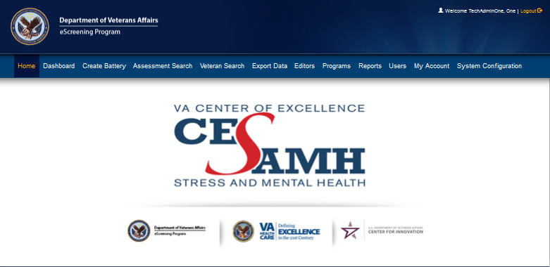
Home screen for administrators
Notes:
MHE designs, performs, and publishes mental health assessments, and contains a data repository and an existing VistA instance.
Components are:
WYSIWYG Editor:
for designing assessment forms and note templates. Staff use the designer to create or edit existing assessment and notes templates; the assessment forms are then used by the assessments runtime and the notes templates are used by the dashboard.
Runtime:
executes assessment forms created by the designer. Veterans “take” assessments by inputting answers into questions within forms based on the templates. The assessment session and the answer to the forms are stored in the repository.
Dashboard:
allows staff to create assessment sessions based on assessment forms, view the status of ongoing assessments, and upload the results of assessments to VistA based on note templates created by the designer. The dashboard uses the repository to track and store assessments and templates.
Database:
A repository of assessment forms, users, ongoing and historical assessments, and assessment metadata used by the designer, runtime, and dashboard.
The next slide shows the integration between MHE, the repository, and VistA:

Slide 20
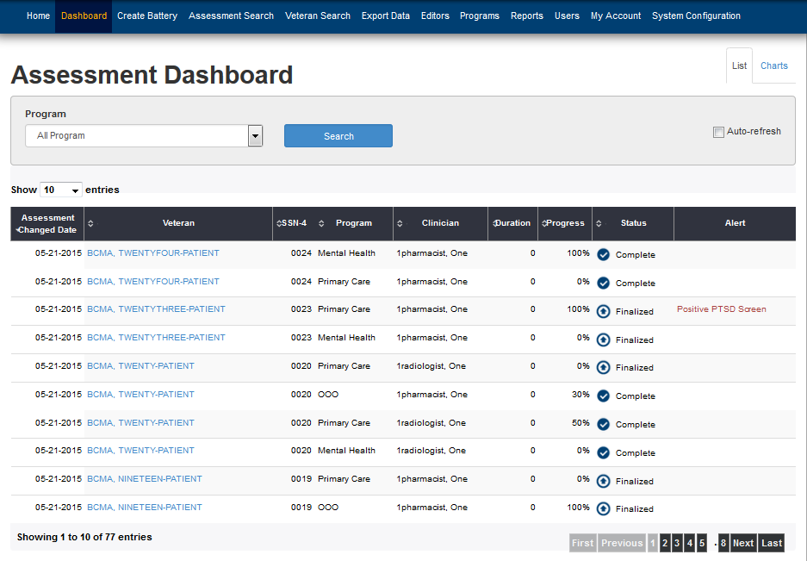
Dashboard tab
Notes:
MHE designs, performs, and publishes mental health assessments, and contains a data repository and an existing VistA instance.
Components are:
WYSIWYG Editor:
for designing assessment forms and note templates. Staff use the designer to create or edit existing assessment and notes templates; the assessment forms are then used by the assessments runtime and the notes templates are used by the dashboard.
Runtime:
executes assessment forms created by the designer. Veterans “take” assessments by inputting answers into questions within forms based on the templates. The assessment session and the answer to the forms are stored in the repository.
Dashboard:
allows staff to create assessment sessions based on assessment forms, view the status of ongoing assessments, and upload the results of assessments to VistA based on note templates created by the designer. The dashboard uses the repository to track and store assessments and templates.
Database:
A repository of assessment forms, users, ongoing and historical assessments, and assessment metadata used by the designer, runtime, and dashboard.
The next slide shows the integration between MHE, the repository, and VistA:

Slide 21
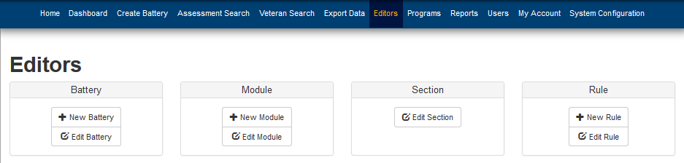
Editors’ tab
Notes:
MHE designs, performs, and publishes mental health assessments, and contains a data repository and an existing VistA instance.
Components are:
WYSIWYG Editor:
for designing assessment forms and note templates. Staff use the designer to create or edit existing assessment and notes templates; the assessment forms are then used by the assessments runtime and the notes templates are used by the dashboard.
Runtime:
executes assessment forms created by the designer. Veterans “take” assessments by inputting answers into questions within forms based on the templates. The assessment session and the answer to the forms are stored in the repository.
Dashboard:
allows staff to create assessment sessions based on assessment forms, view the status of ongoing assessments, and upload the results of assessments to VistA based on note templates created by the designer. The dashboard uses the repository to track and store assessments and templates.
Database:
A repository of assessment forms, users, ongoing and historical assessments, and assessment metadata used by the designer, runtime, and dashboard.
The next slide shows the integration between MHE, the repository, and VistA:

Slide 22
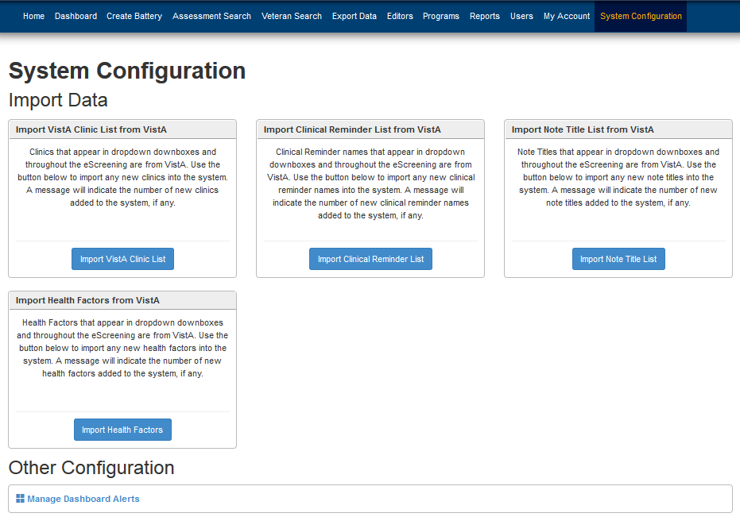
System Configuration tab
Notes:
MHE designs, performs, and publishes mental health assessments, and contains a data repository and an existing VistA instance.
Components are:
WYSIWYG Editor:
for designing assessment forms and note templates. Staff use the designer to create or edit existing assessment and notes templates; the assessment forms are then used by the assessments runtime and the notes templates are used by the dashboard.
Runtime:
executes assessment forms created by the designer. Veterans “take” assessments by inputting answers into questions within forms based on the templates. The assessment session and the answer to the forms are stored in the repository.
Dashboard:
allows staff to create assessment sessions based on assessment forms, view the status of ongoing assessments, and upload the results of assessments to VistA based on note templates created by the designer. The dashboard uses the repository to track and store assessments and templates.
Database:
A repository of assessment forms, users, ongoing and historical assessments, and assessment metadata used by the designer, runtime, and dashboard.
The next slide shows the integration between MHE, the repository, and VistA:

Slide 23
Modules
Hardware
Software
MHE Deployment
Routine Operations
Exception Handling
Operations & Maintenance System Support

Slide 24
MHE Deployment
For steps to deploy MHE, see
MHE_0003AB_System Administration Manual
Located on the VACloud.
Notes:
All communication between MHE and VistA takes place behind VA firewalls via VA VistALink, a Java RPC framework
that is part of the OneVA architecture.
MHE uses VistALink for bidirectional communications between the client and VistA (M) server, and utilizes existing CPRS RPCs
to perform the same actions as CPRS without requiring any VistA code changes.

Slide 25
MHE Deployment Vista Proxy Account
The Proxy Account is the VistA service account that the MHE application uses to connect with VistA. The Proxy account is provided by R01 OIT. The Verify Code for the Proxy account cannot be set to “never expire”.
If you are configuring a new adapter, contact the VistA/M system’s Information Security Officer and/or Manager to obtain the connector proxy user’s credentials for the VistA/M system to which you want to connect. You’ll need:
Access/verify codes and the DUZ for connector proxy user
VistALink listener port
IP address of the VistA/M system

Slide 26
MHE Deployment Pre-requisite
Install JDK 8 from Oracle.
Install and set up Create the MySQL Database.
Install MySQL 5.6.17 community edition (or the latest edition): http://dev.mysql.com/downloads/mysql/
Install Tomcat: http://tomcat.apache.org/download-70.cgi
Install Git: https://git-scm.com/downloads
Install Maven: https://maven.apache.org/download.cgi

Slide 27
MHE Deployment Database Setup
Open the MySQL workbench.
Log into the instance, depending on the type of Tomcat instance being deployed (in other words, test or production).
Run the following to create the new database (replace database_name with the name of each database): CREATE DATABASE IF NOT EXISTS database_name
Create a user for the MHE application, for instance – “escrapp”
Give the escrapp user permissions to build the new database by (replace database_name with the name of each database): GRANT ALL ON database_name.* TO 'escrapp'@'localhost'
Notes:
All communication between MHE and VistA takes place behind VA firewalls via VA VistALink, a Java RPC framework
that is part of the OneVA architecture.
MHE uses VistALink for bidirectional communications between the client and VistA (M) server, and utilizes existing CPRS RPCs
to perform the same actions as CPRS without requiring any VistA code changes.

Slide 28
MHE Deployment Tomcat Instances
Tomcat is installed at D:\apps\tomcat.
If one doesn’t exist, create a new folder D:\apps\tomcatInstances.
Using Windows explorer, navigate to D:\apps\tomcatInstances
Copy and paste instance-template directory to this same directory. The instance-template directory can be found in the source code tree.
Rename the new directory using the convention: <3_letter_abbreviation>-prod
Update the instanceIDs.txt document with a new entry for this new instance with a new unique ID.
Edit the file in: <new instance directory>\conf\server.xml
Update using Notepad:
Server port to 81** where ** is the ID of this server
Http Connector port to 82** where ** is the ID of this server
AJP Connector port to 83** where ** is the ID of this server
Save and close the editor.

Slide 29
MHE Deployment Tomcat Services
Open a terminal/shell with Admin privileges (for example, right-click cmd.exe and select Run as Administrator)
If using power shell, execute: cmd
Run: cd D:\apps\apache-tomcat\bin
Run: set CATALINA_HOME=D:\apps\apache-tomcat
Run: set CATALINA_BASE=D:\apps\tomcatInstances\<new instance directory> Here <new instance directory> is the name of the new base directory created in the previous section. Below “<new_instance_name>” is “tomcat-<new_instance_directory_name>”
Run: .\service install <new_instance_name>
Run: .\tomcat7 //US//<new_instance_name> --Startup=auto –JvmMx=4096

Slide 30
MHE Deployment Tomcat Service Configuration
Run: .\tomcat7w //ES//<new_instance_name>
Set the required JVM settings:
Click the Java tab
Add these settings in the Java Options text box:
-Dfile.encoding=UTF-8
-Dserver
-Dcom.sun.management.jmxremote=true
-Djava.rmi.server.hostname=127.0.0.1
-Dcom.sun.management.jmxremote.port=84**
-Dcom.sun.management.jmxremote.ssl=false
-Dcom.sun.management.jmxremote.authenticate=false
Memory settings can be adjusted here as well.
If this is a production instance, add:
-Dgov.va.med.environment.production=true

Slide 31
MHE Deployment Deploy to Tomcat
To facilitate simple, error-free maintenance, each instance has a separate staging area to manage version and database updates.
In these steps, when <profile_name> is shown, replace this with the name of the Maven profile which has been created for this instance (for example, sdc-prod).
Start Git Bash.
If it doesn’t already exist, create a d:/escreening directory.
Run: cd d:/escreening
Download the latest code by running: Git clone https://github.com/VHAINNOVATIONS/Mental-Health-eScreening.git <profile_name>-release
This operation will create a new directory with eScreening code. For example, the new directory might be called “sdc-prod-release”.

Slide 32
MHE Deployment Deploy to Tomcat
Copy and paste the file deploy-template.sh and deploy.sh files to: d:/escreening from d:/escreening/<profile-name>-prod/deploy/escreening
Make a copy of the deploy-template.sh to deploy-<profile-name>.sh
Modify the deploy-<profile-name>.sh file to fill in the environment specific paremeters.
Run deploy-<profile-name>/sh
Note: Currently the profiles are only set up for SDC, LON, and LAS. In order to add new profiles, modify the POM file to add the new profile, then push to GitHub.

Slide 33
Modules
Hardware
Software
MHE Deployment
Routine Operations
System Start-up and Shut-down
Data Backup and Restore
Setting Up an SSL Certificate
Manage VistA Proxy Account
System monitoring, reporting, & tools
Exception Handling
Operations & Maintenance System Support

Slide 34
Routine Operations System Start-up and Shut-down
Tomcat is running as a Windows Service.
Service names:
SDC-PROD --- Production System for San Diego
LON-PROD ---Production System for Long Beach
Test ------------Test System for both San Diego Test and Long Beach Test.
To start or stop a service:
Right-Click on the service, then click Start, Stop, or Restart.
See screen shot, next slide.
Notes:
Backing up the database is performed at the operating system level.
……………….OK Ming … take it away!

Slide 35
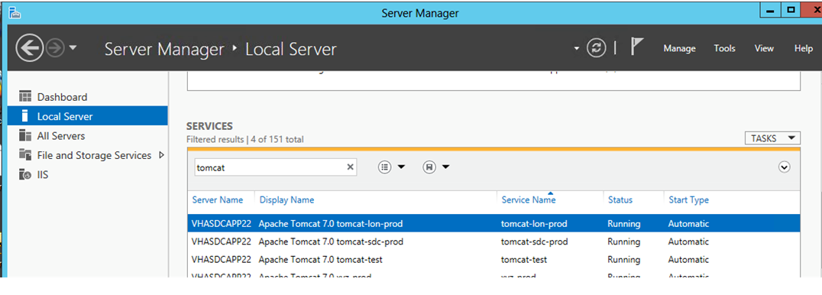
Tomcat Services on the Server

Slide 36
Data Backup and Restore
Warning: To prevent data loss, always run backup before restore.
Run backup.bat from D:/backup folder.
Run restore.bat from D:/backup folder. This restores the database to the last backup that was taken on the system.
Back up testing.
Storage and rotation:
The latest backup is stored in backup.txt file.
When a backup is taken, the previous backup is moved to a folder in the format: yyyyddmmhhmm

Slide 37
Setting up an SSL Certificate
Basic instructions:
http://serverfault.com/questions/466266/installing-ssl-on-a-windows-server-2012-with-iis-8-0

Slide 38
Setting up an SSL Certificate
The SSL certificate expires one year from the issue date. Before the certificate expires, request and install a new certificate:
Create a certificate request from IIS manager, using the same parameters as the existing certificate.
Request the new SSL certificate through this VA site: https://vaww.portal.va.gov/sites/PKI/Lists/SSLTLS%20Requests/AllItems.aspx
See screen shot, next slide:

Slide 39
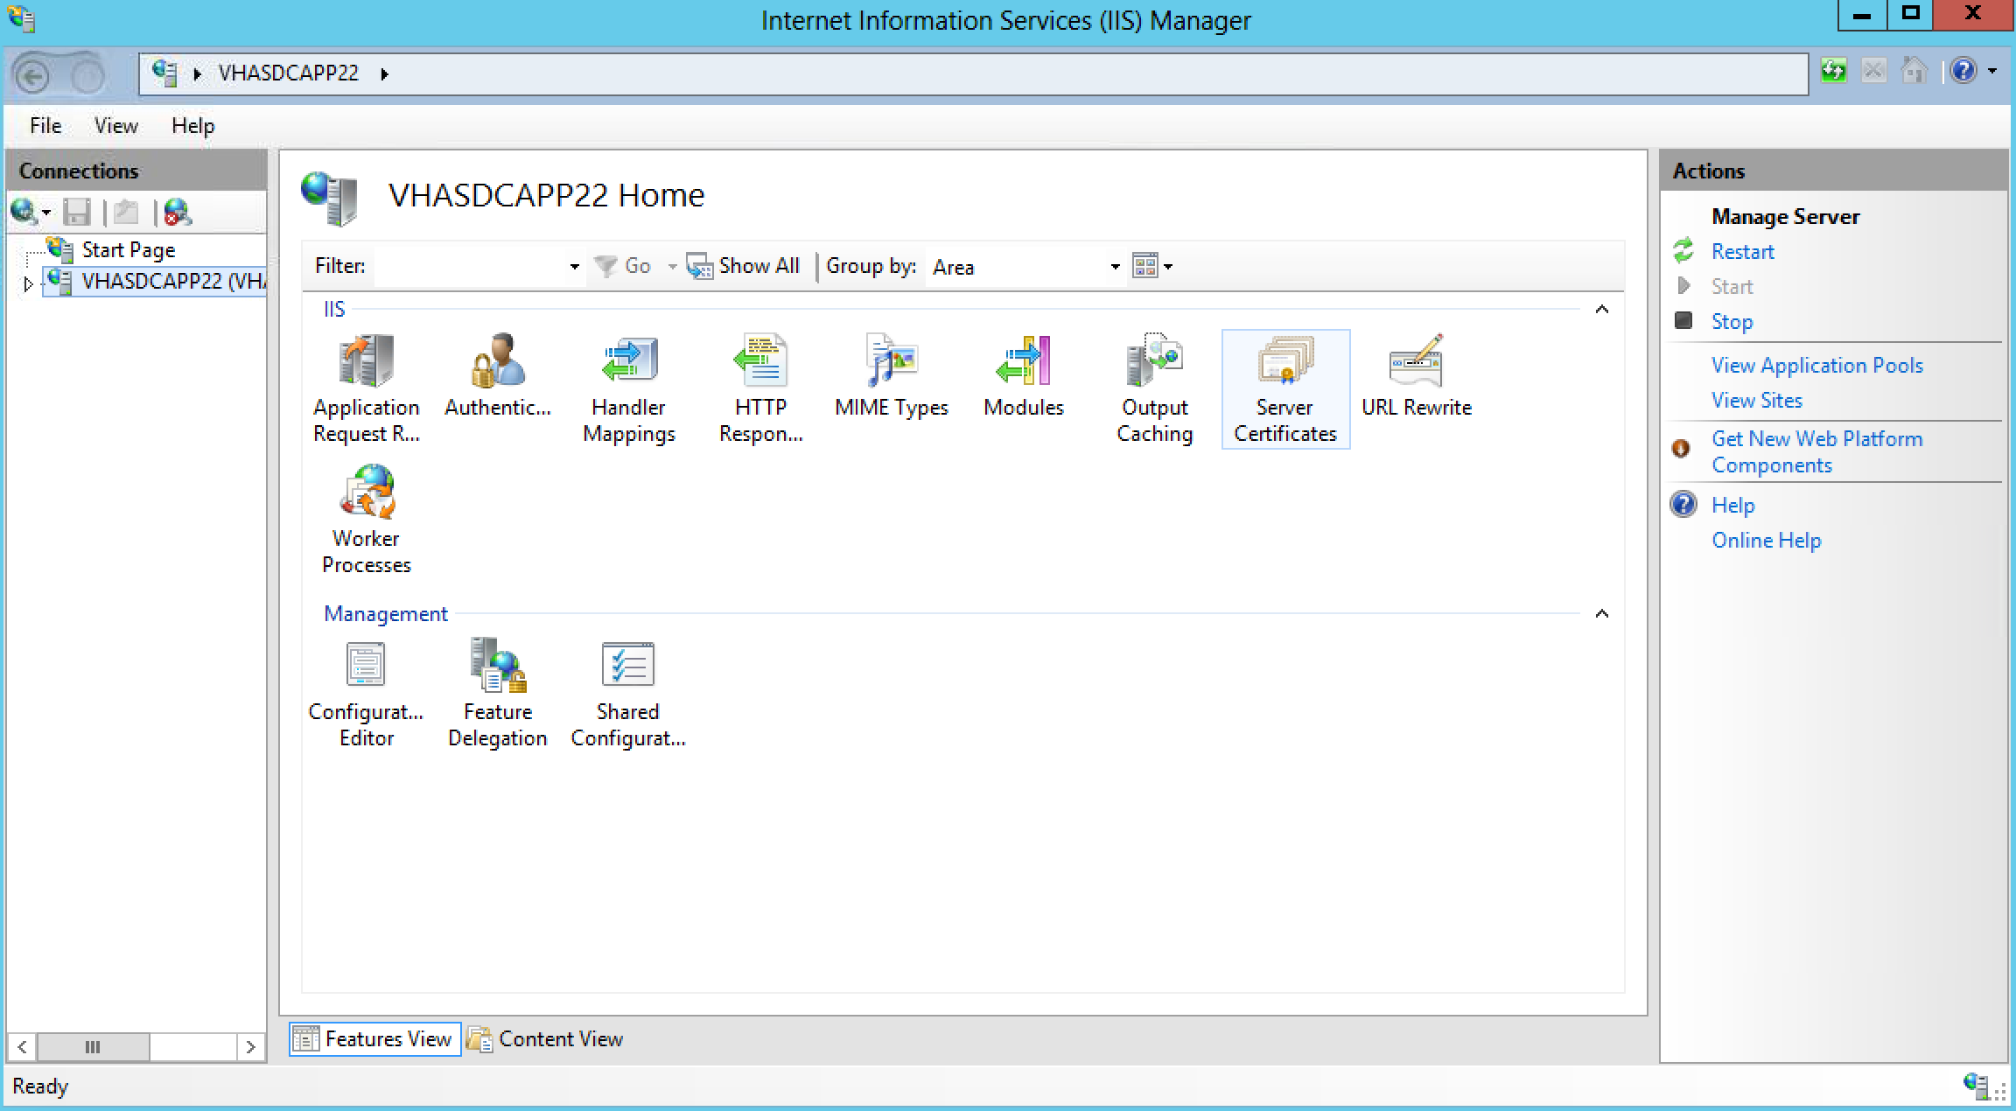
Setting up an SSL Certificate

Slide 40
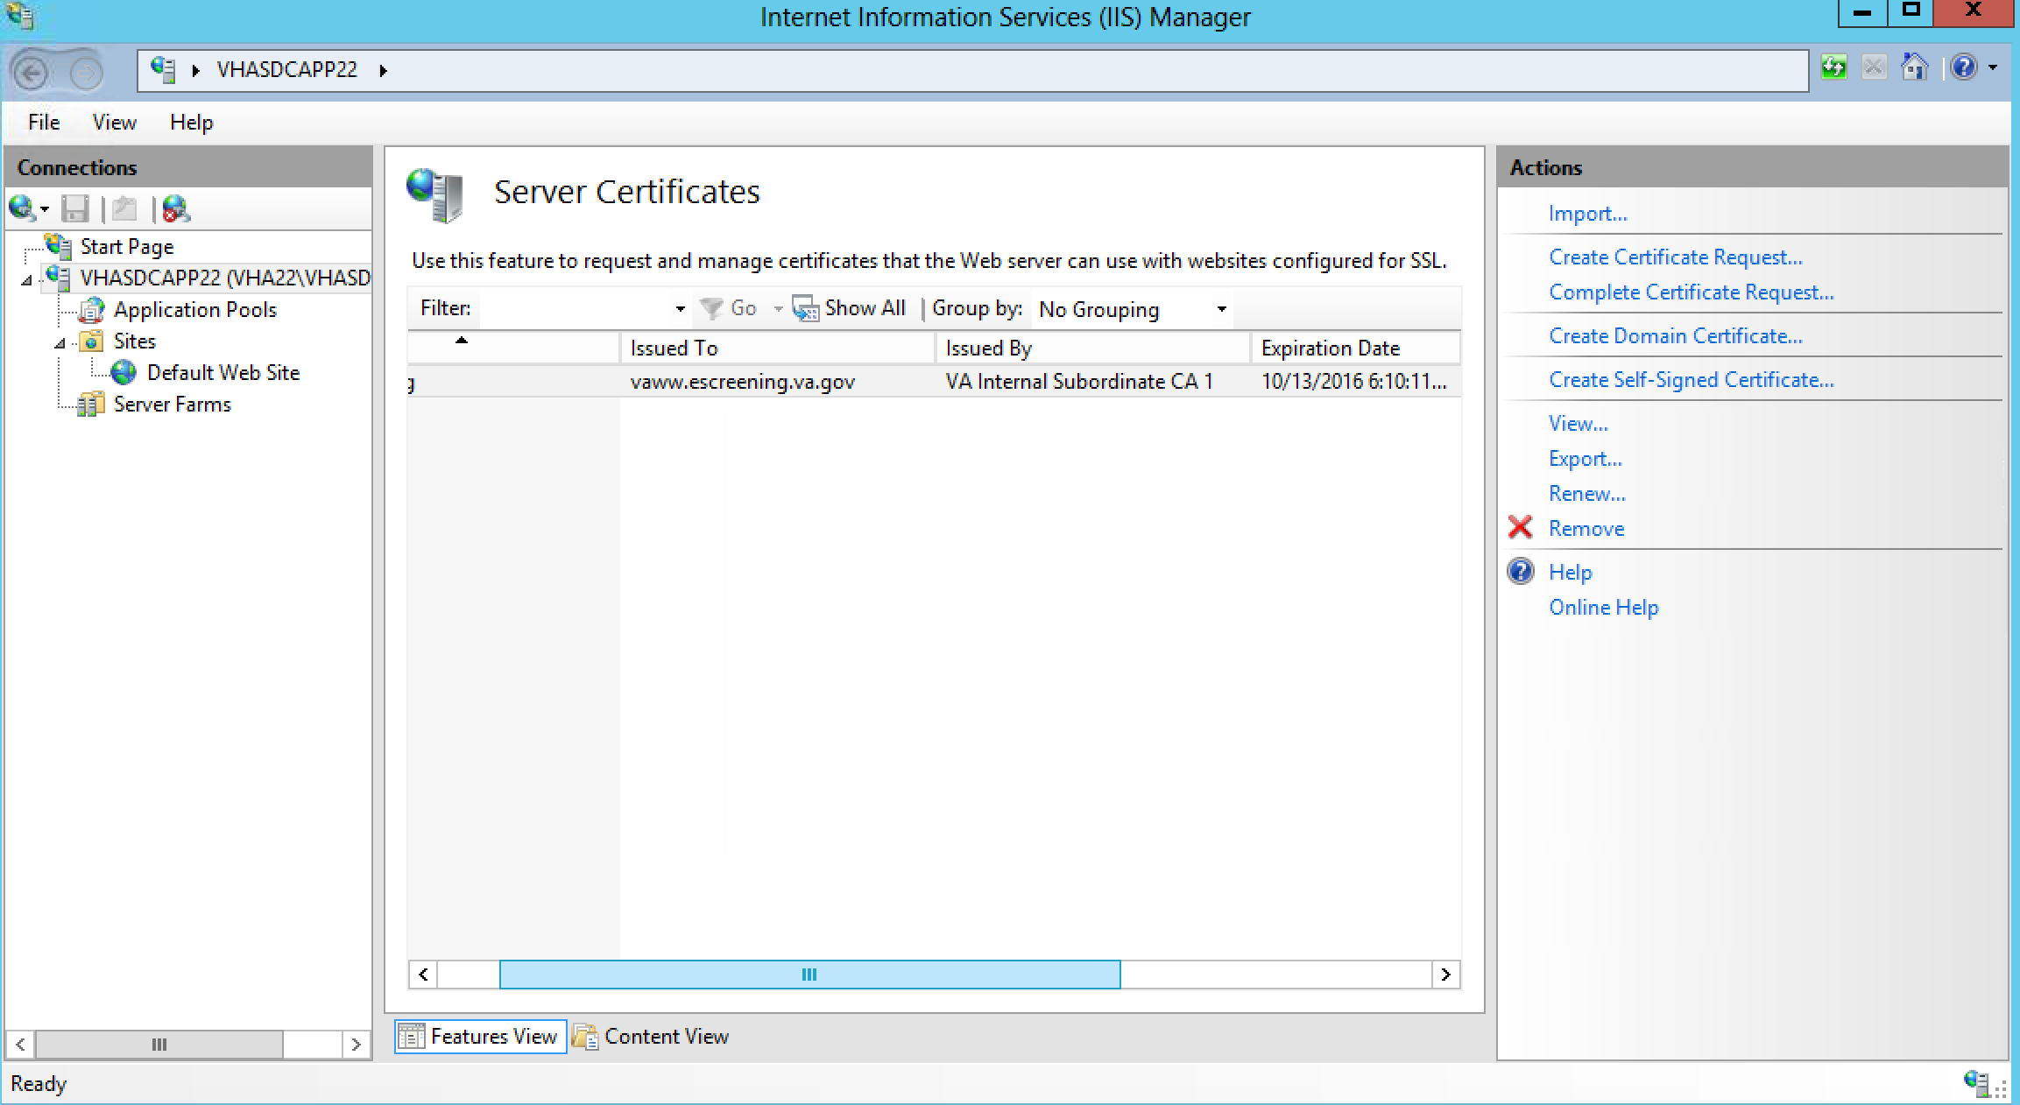
Setting up an SSL Certificate

Slide 41
Setting up an SSL Certificate
The turnaround for the certificate is within a few days.
After you receive the new certificate, install it by clicking the Complete Request button.
Switch the default site’s SSL certificate to the new certificate: Click Sites-->Default Web Site -->Binding, and select the new certificate.
See screen shot, next slide:

Slide 42
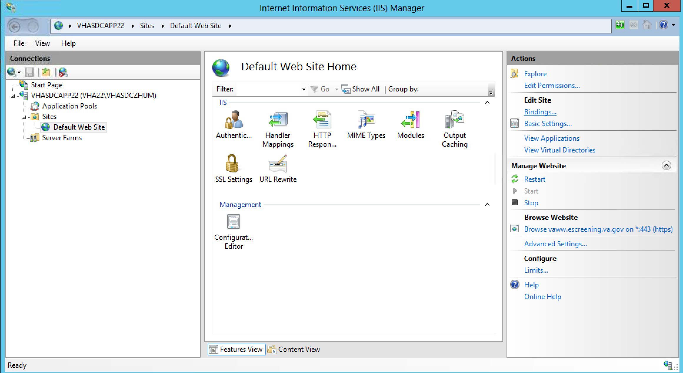
Setting up an SSL Certificate

Slide 43
System monitoring, reporting, & tools
Use VA’s enterprising monitoring suite to perform system monitoring.
Establish probes for:
operating the system CPU,
memory,
disk space, and
the Tomcat and MySQL processes.

Slide 44
System monitoring, reporting, & tools
Availability Monitoring
Probe the status controller regularly (for example, every 10 minutes) for the application’s availability.
This keeps the Java VM warm and allows the monitoring tool to test the status of system components such as the database and VistA connectivity.
Application Status Checks:
Concern | Test
Web application | Application: OK
Database connectivity | Database: OK
VistA connectivity | VistA: OK

Slide 45
System monitoring, reporting, & tools
Loading the status screen checks the application status in general, as well as the database and VistA connectivity.
In addition to automated monitoring, you can check this screen manually to determine the status of the system after a deployment or patch, or during troubleshooting.

Slide 46
System monitoring, reporting, & tools
Performance and Capacity Monitoring
MHE’s performance and capacity management consists of:
verifying system performance through page loads and log analysis, and
verifying capacity through disk and network analysis.
Page performance verification is currently a manual process performed by the system administrator as per VA guidelines. Ongoing page performance analysis can be performed by scraping the application server logs for page response times.

Slide 47
System monitoring, reporting, & tools
Performance/Capacity Monitoring
There are three stated KPIs:
Action | Threshold | Verification
Initial page load | 15 seconds | Manual
Subsequent page load | 3 seconds | Manual
Assessment upload | 5 seconds | Log analysis

Slide 48
System monitoring, reporting, & tools
MHE disk and network capacity can be assessed by the system administrator or NEDIIS per VA guidelines.
Free space can be queried via VA’s enterprise monitoring tool (example, SolarWinds, etc.). Network link capacity can be accessed via ongoing link analysis via the network OSS team or NEDIIS. For more details on disk or link analysis, see VA guidelines.
Procedures for Monitoring Capacity:
Element | Procedure | Actor
Disk space | Disk free probe | System administrator
Network links | NetScout ongoing analysis | NEDIIS
30 concurrent users/site | Log analysis | System administrator

Slide 49
Modules
Hardware
Software Description
MHE Deployment
Routine Operations
Exception Handling
Troubleshooting
Operations & Maintenance System Support

Slide 50
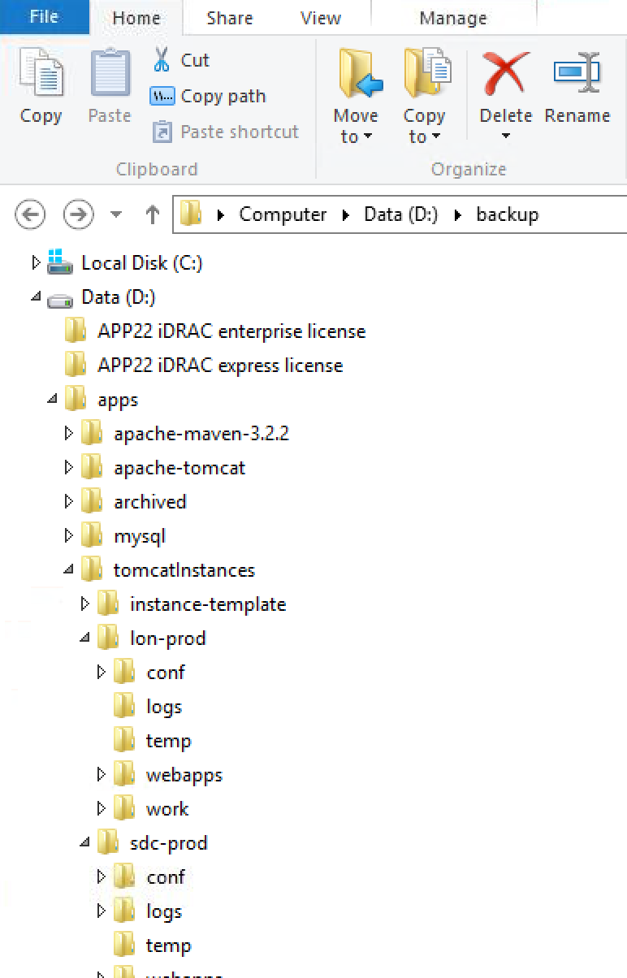
Exception Handling Troubleshooting
Application error logs
The application logs are under the tomcat instance folder. Here is the folder structure.
Log files are rotated by size.
Application error codes & descriptions
Infrastructure errors (database, web/application server, network, or authentication & authorization)

Slide 51
Exception Handling Troubleshooting
Runtime errors in eScreening are typically related to configuration, connectivity, or data issues. Errors related to connecting to the eScreening database, configuration, and bad or unmatched Veteran data can be resolved locally by the system administrator.
Type | Examples
Locally resolvable | Unmatched records, bad data, DB connectivity
Externally resolvable | Network or VistA issues
Unresolvable | Errors due to bugs

Slide 52
Exception Handling Troubleshooting
See the System Administration Manual, located in the VA Cloud, for routine errors (security, time-outs, and concurrency), and significant errors (application error logs, codes and descriptions, and infrastructure errors.
Additionally, the manual details dependent systems, troubleshooting, and system recovery (restarts and back out procedures).

Slide 53
Modules
Hardware
Software Description
MHE Deployment
Routine Operations
Exception Handling
Operations & Maintenance System Support

Slide 54
Operations & Maintenance System Support
See the System Administration Manual, located in the VA Cloud, for support structure, hierarchy, division of responsibilities, and support procedures.

Slide 55
Congratulations!
You have completed
Mental Health eScreening System Administration Training!

